Slide 1
NLP & Convolutional Neural Networks
W266: Natural Language Processing

Slide 2
Peeking ahead...
Week 1- 2: NN Basics & Training
Week 3: Classification & Sentiment
Week 4: Part of Speech + Parsing
Week 5: Convolutional Neural Networks (CNNs)
Project Proposal Due Feb 6 (Saturday)
Week 6 - 7: Language Models
Week 8: Machine Translation
Week 9: Advanced MT: Transformers & Transfer Learning
Week 10: Entities/Information Extraction
Week 11: Summarization and a touch of question answering
Week 12: Document Classification
Week 13: Information Retrieval

Slide 3
Announcements
Assignment 4 to be released Saturday 02/06.
Project Proposals - Due This Saturday 02/06!
Proposal requirements are here:
One proposal per group
200 - 300 words
Four references minimum
Submit your Google doc proposal via this form
Questions?
Paper reading sessions (next week):
Underspecification Presents Challenges for Credibility in Modern Machine Learning
Zach: Thursday 2/11 5:40 pm PST
Concerns?

Slide 4
Today’s plan...
“CNNs? What’s that?” (10 min)
Sample CNN architecture & intuition
Literature & applications beyond NLP
Deconstructing CNNs (40 min)
Layers (Inputs, convolution layer, activation, pooling, FC layers, cost function)
Regularization (dropout)
Comments on additional topics (attention, jumping layers,...)
CNNs in NLP (40 min)
Common designs
NLP Applications (classification, translation,..)
Pros & Cons (comparison to other techniques)

Slide 5
Recap...
W266: Natural Language Processing

Slide 6
Parsing: Overview
Parsing: tree-structured prediction
Types of Parsing:
Dependency
Constituency / phrase-structure
(Semantic)
Parsing Techniques / Algorithms:
Transition-based
Graph-based
Chart-based
Similar goal: find the best tree. Different formalisms, but similar algorithms used for all types.
Notes:
Also top-down vs. bottom-up. We’ll mostly consider bottom-up in this class, but top-down algorithms are similar.

Slide 7
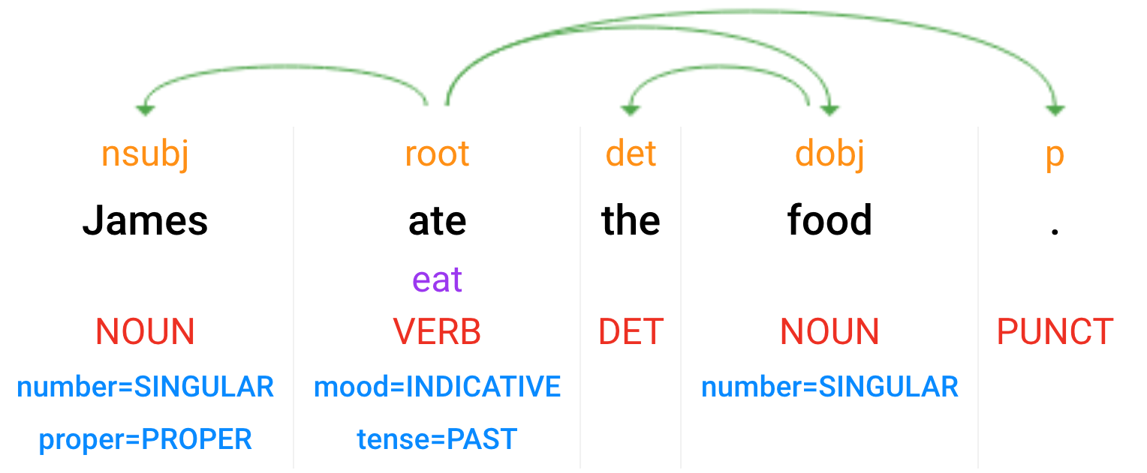
Syntactic Analysis
Parsey McParseface: https://cloud.google.com/natural-language/
Dependency Parse
(+ dependency types)
Lemmas
Part-of-Speech Tags
Morphology
Notes:
Scroll down for the test console

Slide 8
Mathematically equivalent: one-hot & word vectors
Usually presented as a “lookup” in some table, but…
(Only) think of a word as a one-hot vector:
X = [0 0 1 … 0 0 …. 0 0 0]
Then we do matrix multiplication:
“the”
W
E =
0 0 1 0 0 0 0
X
3rd row is Vector for “the”
Word Embeddings!
.
.
.
Reasonable that similar words end up with similar vectors
Notes:
Key idea: map discrete things (words) into a continuous feature space.
Conceptually, just a big matrix multiply. But since one-hot vector is very sparse, convenient to just extract the column by indexing. So often we’ll refer to this as a “lookup”. (In fact, you can even shard embeddings across different servers, and just pull in the one you need!)

Slide 9
Neural Bag of Words Model
Discussion:
What to use for binary decisions, what for multi-class classification?
What is the dimension of the last affine layer?
How do we interpret the softmax output?
Sigmoid Or Softmax
Affine
z = xW + b
Affine
Nonlinearity
Affine
(Literally) sum vectors
(“bag of words”)
+
e₁ e₂ e₃ e₄ e₅
w₁ w₂ w₃ w₄ w₅
Notes:
2-4 minute slide. Discuss network end-to-end starting with input word embeddings, summation to get sentence representation, feed through DNN layers and then used for softmax classification.

Slide 10
Neural Bag of Words Model - Issues
Sigmoid Or Softmax
Issues:
Word ordering not preserved
No sense of larger context
….
There should be something better...:
CNNs (Today)
RNNs (Week 7)
Affine
Nonlinearity
Affine
Sum vectors
(“bag of words”)
+
e₁ e₂ e₃ e₄ e₅
w₁ w₂ w₃ w₄ w₅
Notes:
2-4 minute slide. Discuss network end-to-end starting with input word embeddings, summation to get sentence representation, feed through DNN layers and then used for softmax classification.

Slide 11
“CNN? What’s That?”
W266: Natural Language Processing

Slide 12
Why Not Just Standard FC NN for Images and Text?
Way too many parameters, and more! Images:
Imagine 256 x 256 image in 3 colors, fully connecting to 256 x 256 x 12 dimensional output layer… how many parameters? (256 x 256 x 3) x (256 x 256 x 12) + (256 x 256 x 12) ~ 154 bn
Text:
Imagine you concatenate 300 words with 200-d embedding, fully connecting to a layer of same size… how many parameters? (300 x 200) x (300 x 200) + (300 x 200) ~ 3.6 bn
(weights)
(biases)
(weights)
(biases)
Notes:
Also, perhaps say 256 x 256 x 3 image is an input feature vector of length 196,608. As we know from A1, the weight matrix is [input x output] shaped, so even if we wanted to do a huge dimensionality reduction in the first layer from a ~200K input vector down to ~1000 output, how many parameters are in the weight matrix?
(Also, some commentary that we don't want to have to learn about a pattern separately when it occurs in each part of the image, that maybe we can do a better generalization by learning about a pattern and being able to apply it generally).
Another tie-in, which we may not have time except a passing reference is that in old-school image processing, humans would make their own "kernels" (filters). CNNs simply learn those kernels automatically.

Slide 13
Why Not Just Standard FC NN for Images and Text?
Way too many parameters, and more! Images:
Imagine 256 x 256 image in 3 colors, fully connecting to 256 x 256 x 12 dimensional output layer… how many parameters? (256 x 256 x 3) x (256 x 256 x 12) + (256 x 256 x 12) ~ 154 bn
Text:
Imagine you concatenate 300 words with 200-d embedding, fully connecting to a layer of same size… how many parameters? (300 x 200) x (300 x 200) + (300 x 200) ~ 3.6 bn
Quite unworkable
and not aligned with problem
(weights)
(biases)
(weights)
(biases)
Notes:
Also, perhaps say 256 x 256 x 3 image is an input feature vector of length 196,608. As we know from A1, the weight matrix is [input x output] shaped, so even if we wanted to do a huge dimensionality reduction in the first layer from a ~200K input vector down to ~1000 output, how many parameters are in the weight matrix?
(Also, some commentary that we don't want to have to learn about a pattern separately when it occurs in each part of the image, that maybe we can do a better generalization by learning about a pattern and being able to apply it generally).
Another tie-in, which we may not have time except a passing reference is that in old-school image processing, humans would make their own "kernels" (filters). CNNs simply learn those kernels automatically.

Slide 14
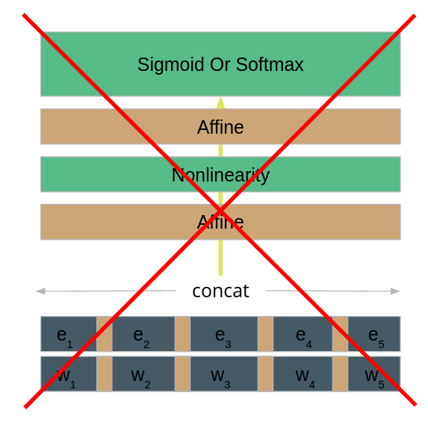
Brainstorming
Other issues, besides # of parameters?
How could we improve this? Think:
“How do I try to detect whether an image contains a bicycle?”
“How do I detect whether a tweet contains foul language?”
What do you actually do? And how could we take that idea to neural nets?

Slide 15
That’s Why: Convolutional Neural Nets (CNNs)
Greatly reducing parameters! Critical Observations:
Many features are ‘local’, i.e., one needs to inspect only small neighborhood to detect
Often, it does not matter where an object or a word phrase is (“I just care that there is a bird, not where it is”)
Core Idea: “Slide small window across image/text and that looks locally for ‘features’”
Neurons in output layer only ‘see’ small neighborhood
The same parameters are used across image/text. MUCH cheaper!
Notes:
But this is just the surface!

Slide 16

Broad Usage of CNNs in Current Research
Many publications using CNNs! Some topics of papers on arXiv.org using CNNs… in Jan ’ 21 (~200 papers):
Image Recognition and Processing
NLP
General NN research
Acoustics & Signal Processing
Genomics
Medical Diagnostics
Cybersecurity and Malware Detection
Finance
Law
Physics and Fluid Dynamics
Geophysics
….
Notes:
But this is just the surface!

Slide 17
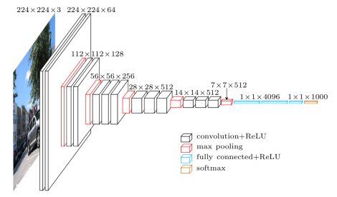
A Classic CNN Architecture in Computer Vision: VGG16
Oxford University’s ‘Visual Geometry Group’, Simonyan & Zisserman, 2014 see: “Very Deep Convolutional Networks for Large-Scale Image Recognition”, https://arxiv.org/pdf/1409.1556.pdf
Immediate Observations?
Image Source: https://www.cs.toronto.edu/~frossard/post/vgg16/
Notes:
But this is just the surface!

Slide 18
A Classic CNN Architecture in Computer Vision: VGG16
Oxford University’s ‘Visual Geometry Group’, Simonyan & Zisserman, 2014 see: “Very Deep Convolutional Networks for Large-Scale Image Recognition”, https://arxiv.org/pdf/1409.1556.pdf
Immediate Observations?
“Many” Layers (deep)
Different types of layers (convolutional, pooling)
“Depth” of layers
“Squeezing”
Image Source: https://www.cs.toronto.edu/~frossard/post/vgg16/
Notes:
But this is just the surface!

Slide 19
A Classic CNN Architecture in Computer Vision: VGG16
Oxford University’s ‘Visual Geometry Group’, Simonyan & Zisserman, 2014 see: “Very Deep Convolutional Networks for Large-Scale Image Recognition”, https://arxiv.org/pdf/1409.1556.pdf
Immediate Observations?
“Many” Layers (deep)
Different types of layers (convolutional, pooling)
“Depth” of layers
“Squeezing”
Key Technique: Next layer is generated by moving ‘filters’ across the previous layer...
Image Source: https://www.cs.toronto.edu/~frossard/post/vgg16/
Notes:
But this is just the surface!

Slide 20
Input: 12 * 12 * 64
Kernel size: 4
Filter size: 3 x 3 x 64
# of filters: 32
Step size: 2
Padding: no padding
Output: 5 * 5 * 32 ?
Positions: 1, 3, 5, 7, 9

Slide 21
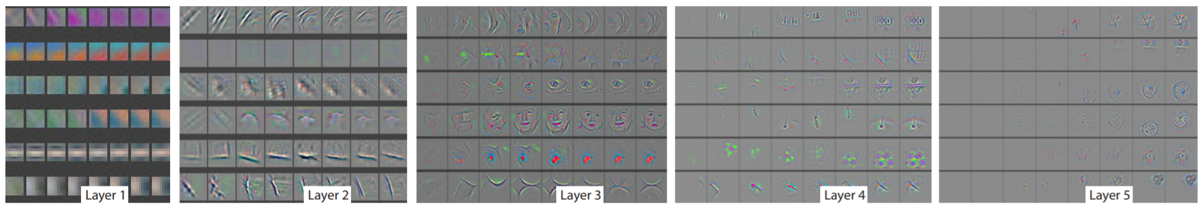
Learning
Early layers learn concrete features (edges, etc.)
Deeper layers learn more abstract features
Source: “Visualizing and Understanding Convolutional Neural Networks”, Zeiler & Fergus, NYU https://arxiv.org/pdf/1311.2901.pdf
Notes:
But this is just the surface!

Slide 22
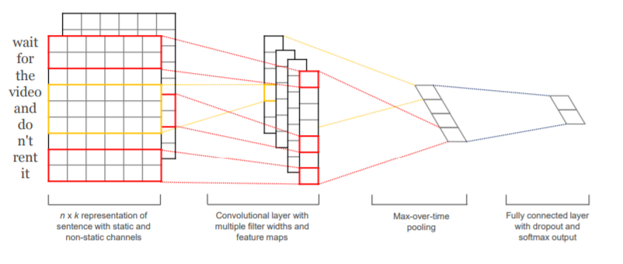
What About NLP & CNNs?
Intuition: Similar idea*!
“From individual features (words) to text segments to ‘meaning’”
Source: “Convolutional Neural Networks for Sentence Classification”,Kim, NYU https://arxiv.org/pdf/1408.5882.pdf
*Location invariance? Not ideal in general for language (RNNs are more suited in that regard)
Notes:
But this is just the surface!

Slide 23
Deconstructing CNNs (Sample Case: Vision)
W266: Natural Language Processing

Slide 24
Layers: Convolutional Layer
Assume you want to build an “Edge Detector” for an image… what matters?
Observations:
“Edge” is a local concept, i.e., only need to look at small neighborhood
“An edge is an edge”, wherever it is in image, i.e. translational symmetry
Simple Example: 1D
Original “Image”
Goal: Detected Edges
Notes:
But this is just the surface!

Slide 25
Layers: Convolutional Layer (plus Activation)
Idea: slide window across image
Convert to numbers
0 | 0 | 0 | 1 | 1 | 1 | 0 | 0 | 1 | 1 | 1 | 1 | 0 | 0
x
x
x
? | ? | ?
+
? | ? | ? | ? | ? | ? | ? | ? | ? | ? | ? | ?
Apply non-linearity (RELU)
0 | 0 | 1 | 0 | 1 | 0 | 0 | 1 | 0 | 0 | 1 | 0
Notes:
But this is just the surface!

Slide 26
Layers: Convolutional Layer (plus Activation)
Idea: slide window across image
Convert to numbers
0 | 0 | 0 | 1 | 1 | 1 | 0 | 0 | 1 | 1 | 1 | 1 | 0 | 0
x
x
x
-1 | 2 | -1
+
0 | ? | ? | ? | ? | ? | ? | ? | ? | ? | ? | ?
Apply non-linearity (RELU)
0 | ? | ? | ? | ? | ? | ? | ? | ? | ? | ? | ?
Notes:
But this is just the surface!

Slide 27
Layers: Convolutional Layer (plus Activation)
Idea: slide window across image
Convert to numbers
0 | 0 | 0 | 1 | 1 | 1 | 0 | 0 | 1 | 1 | 1 | 1 | 0 | 0
x
x
x
-1 | 2 | -1
+
0 | -1 | 1 | 0 | 1 | ? | ? | ? | ? | ? | ? | ?
Apply non-linearity (RELU)
0 | 0 | 1 | 0 | 1 | ? | ? | ? | ? | ? | ? | ?
Notes:
But this is just the surface!

Slide 28
Layers: Convolutional Layer (plus Activation)
Idea: slide window across image
Convert to numbers
0 | 0 | 0 | 1 | 1 | 1 | 0 | 0 | 1 | 1 | 1 | 1 | 0 | 0
x
x
x
-1 | 2 | -1
+
0 | -1 | 1 | 0 | 1 | 0 | -1 | 1 | 0 | 0 | 1 | -1
Apply non-linearity (RELU)
0 | 0 | 1 | 0 | 1 | 0 | 0 | 1 | 0 | 0 | 1 | 0
Notes:
But this is just the surface!

Slide 29
Layers: Convolutional Layer
Side Question: “Why not simple window of length 2?”
0 | 0 | 0 | 1 | 1 | 1 | 0 | 0 | 1 | 1 | 1 | 1 | 0 | 0
1 | -1
Notes:
But this is just the surface!

Slide 30
Layers: Convolutional Layer
Side Question: “Why not simple window of length 2?”
0 | 0 | 0 | 1 | 1 | 1 | 0 | 0 | 1 | 1 | 1 | 1 | 0 | 0
1 | -1
0 | 0 | -1 | 0 | 0 | 1 | 0 | -1 | 0 | 0 | 0 | 1 | 0
Notes:
But this is just the surface!

Slide 31
Layers: Convolutional Layer
Side Question: “Why not simple window of length 2?”
0 | 0 | 0 | 1 | 1 | 1 | 0 | 0 | 1 | 1 | 1 | 1 | 0 | 0
1 | -1
0 | 0 | -1 | 0 | 0 | 1 | 0 | -1 | 0 | 0 | 0 | 1 | 0
Won’t survive non-linearity (activation)!
Notes:
But this is just the surface!

Slide 32
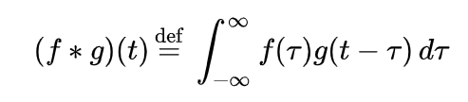
Layers: Convolutional Layer - Comments
Wikipedia Definition of Convolution: That’s very similar to what we did!
g: ‘image’ (digitized)
f: ‘flipped’ window with weights
t: ‘step’ in image
tau: position of neighbor to consider relative to step
Integral: sum in our case
Why not an infinite sum for us? Choose ‘f = 0’ outside of window then it looks like it..
Notes:
But this is just the surface!

Slide 33
Layers: Convolutional Layer - Comments
Interpretation in Neural Net language:
Not fully-connected!
Each output neuron only sees small number of input neurons. (Term: ‘Receptive Field’)
Parameter-sharing
Wherever you are in image, the weights are the same (for the same convolution)
Stride size: step size between window-evals (here: 1)
Padding: do you want to pad input with zeros, so that you can start at 1st point preserving size? That’s yet another hyper-parameter
Notes:
But this is just the surface!

Slide 34
Layers: Can We Look For More Features?
Introducing more filters to ‘look’ for more features: depth!
0 | 0 | 0 | 1 | 1 | 1 | 0 | 0 | 1 | 1 | 1 | 1 | 0 | 0
W_{A1} | W_{A2} | W_{A3}
“Search for ‘vertical edges’...”
. | ... | ... | ... | ... | ... | ... | ... | ... | ... | ... | ... | ... | ...
Notes:
But this is just the surface!

Slide 35
Layers: Can We Look For More Features?
Introducing more filters to ‘look’ for more features: depth!
0 | 0 | 0 | 1 | 1 | 1 | 0 | 0 | 1 | 1 | 1 | 1 | 0 | 0
W_{A1} | W_{A2} | W_{A3}
“Search for ‘vertical edges’...”
W_{B1} | W_{B2} | W_{B3}
“Search for ‘horizontal edges’ ….”
Resulting layer has depth!
. | ... | ... | ... | ... | ... | ... | ... | ... | ... | ... | ... | ... | ...
... | ... | ... | ... | ... | ... | ... | ... | ... | ... | ... | ... | ... | ...
Notes:
But this is just the surface!

Slide 36
Layers: Can We Look For More Features?
Introducing more filters to ‘look’ for more features: depth!
0 | 0 | 0 | 1 | 1 | 1 | 0 | 0 | 1 | 1 | 1 | 1 | 0 | 0
W_{A1} | W_{A2} | W_{A3}
“Search for ‘vertical edges’...”
W_{B1} | W_{B2} | W_{B3}
“Search for ‘horizontal edges’ ….”
W_{C1} | W_{C2} | W_{C3}
“Search for ...”
Resulting layer has depth!
. | ... | ... | ... | ... | ... | ... | ... | ... | ... | ... | ... | ... | ...
... | ... | ... | ... | ... | ... | ... | ... | ... | ... | ... | ... | ... | ...
... | ... | ... | ... | ... | ... | ... | ... | ... | ... | ... | ... | ... | ...
Notes:
But this is just the surface!

Slide 37
Layers: How Do We Continue?
Input for next layer has Depth!
x₁₁ | x₁₂ | x₁₃ | x₁₄ | ... | ... | ... | ... | ... | ... | ... | ... | ... | ...
x₂₁ | x₂₂ | x₂₃ | x₂₄ | ... | ... | ... | ... | ... | ... | ... | ... | ... | ...
x₃₁ | x₃₂ | x₃₃ | x₃₄ | ... | ... | ... | ... | ... | ... | ... | ... | ... | ...
Notes:
But this is just the surface!

Slide 38
Layers: How Do We Continue?
Filters are now matrices...
x₁₁ | x₁₂ | x₁₃ | x₁₄ | ... | ... | ... | ... | ... | ... | ... | ... | ... | ...
x₂₁ | x₂₂ | x₂₃ | x₂₄ | ... | ... | ... | ... | ... | ... | ... | ... | ... | ...
x₃₁ | x₃₂ | x₃₃ | x₃₄ | ... | ... | ... | ... | ... | ... | ... | ... | ... | ...
W_{A11} | W_{A12} | W_{A13}
W_{A21} | W_{A22} | W_{A23}
W_{A31} | W_{A32} | W_{A33}
Notes:
But this is just the surface!

Slide 39
Layers: How Do We Continue?
Filters are now matrices...
x₁₁ | x₁₂ | x₁₃ | x₁₄ | ... | ... | ... | ... | ... | ... | ... | ... | ... | ...
x₂₁ | x₂₂ | x₂₃ | x₂₄ | ... | ... | ... | ... | ... | ... | ... | ... | ... | ...
x₃₁ | x₃₂ | x₃₃ | x₃₄ | ... | ... | ... | ... | ... | ... | ... | ... | ... | ...
W_{A11} | W_{A12} | W_{A13}
z_{A2} = ∑_{ij} x_{ij} * W_{Aij} + b_{A} _{(i,j = 1,2,3 in this case)}
W_{A21} | W_{A22} | W_{A23}
W_{A31} | W_{A32} | W_{A33}
y_{A2} | ... | ... | ... | ... | ... | ... | ... | ... | ... | ... | ...
Notes:
But this is just the surface!

Slide 40
Layers: How Do We Continue?
Filters are now matrices...
x₁₁ | x₁₂ | x₁₃ | x₁₄ | ... | ... | ... | ... | ... | ... | ... | ... | ... | ...
x₂₁ | x₂₂ | x₂₃ | x₂₄ | ... | ... | ... | ... | ... | ... | ... | ... | ... | ...
x₃₁ | x₃₂ | x₃₃ | x₃₄ | ... | ... | ... | ... | ... | ... | ... | ... | ... | ...
W_{A11} | W_{A12} | W_{A13}
y_{A2} = ∑_{ij} x_{ij} * W_{Aij} + b_{A} = Tr (x₂ * W_{A}^{T}) + b_{A}
_{(i,j = 1,2,3 in this case)}
W_{A21} | W_{A22} | W_{A23}
W_{A31} | W_{A32} | W_{A33}
y_{A2} | ... | ... | ... | ... | ... | ... | ... | ... | ... | ... | ...
Notes:
But this is just the surface!

Slide 41
Layers: How Do We Continue?
= x_{k}
Filters are now matrices...
x₁₁ | x₁₂ | x₁₃ | x₁₄ | ... | x_{1(k-1)} | x_{1k} | x_{1(k+1)} | ... | ... | ... | ... | ... | ...
x₂₁ | x₂₂ | x₂₃ | x₂₄ | ... | x_{2(k-1)} | x_{2k} | x_{2(k+1)} | ... | ... | ... | ... | ... | ...
x₃₁ | x₃₂ | x₃₃ | x₃₄ | ... | x_{3(k-1)} | x_{k7} | x_{3(k+1)} | ... | ... | ... | ... | ... | ...
W_{A11} | W_{A12} | W_{A13}
W_{A21} | W_{A22} | W_{A23}
y_{Ak} = ∑_{ij} x_{(k-2+i)j} * W_{Aij} + b_{A}
= Tr (x_{k} * W_{A}^{T}) + b_{A}
W_{A31} | W_{A32} | W_{A33}
y_{A2} | ... | ... | ... | ... | y_{Ak} | ... | ... | ... | ... | ... | ...
Notes:
But this is just the surface!

Slide 42
Layers: How Do We Continue?
Filters are now matrices...
x₁₁ | x₁₂ | x₁₃ | x₁₄ | ... | ... | ... | ... | ... | ... | ... | ... | ... | ...
x₂₁ | x₂₂ | x₂₃ | x₂₄ | ... | ... | ... | ... | ... | ... | ... | ... | ... | ...
x₃₁ | x₃₂ | x₃₃ | x₃₄ | ... | ... | ... | ... | ... | ... | ... | ... | ... | ...
W_{A11} | W_{A21} | W_{A13}
W_{B11} | W_{B12} | W_{B13}
W_{A21} | W_{A22} | W_{A23}
W_{B21} | W_{B22} | W_{B23}
W_{A31} | W_{A32} | W_{A33}
W_{B31} | W_{B32} | W_{B33}
y_{A2} | ... | ... | ... | ... | ... | ... | ... | ... | ... | ... | ...
y_{B2} | ... | ... | ... | ... | ... | ... | ... | ... | ... | ... | ...
Notes:
But this is just the surface!

Slide 43
Layers: Dimensions?
x₁₁ | x₁₂ | x₁₃ | x₁₄ | ... | ... | ... | ... | ... | ... | ... | ... | ... | ...
x₂₁ | x₂₂ | x₂₃ | x₂₄ | ... | ... | ... | ... | ... | ... | ... | ... | ... | ...
x₃₁ | x₃₂ | x₃₃ | x₃₄ | ... | ... | ... | ... | ... | ... | ... | ... | ... | ...
W_{A11} | W_{A21} | W_{A13}
W_{Ail}
W_{B11} | W_{B12} | W_{B13}
W_{A21} | W_{A22} | W_{A23}
‘Length’ of filter
W_{B21} | W_{B22} | W_{B23}
W_{A31} | W_{A32} | W_{A33}
W_{B31} | W_{B32} | W_{B33}
Number of Filter
Thickness of source layer
Number of Filters
y_{A2} | ... | ... | ... | ... | ... | ... | ... | ... | ... | ... | ...
y_{B2} | ... | ... | ... | ... | ... | ... | ... | ... | ... | ... | ...
Notes:
But this is just the surface!

Slide 44
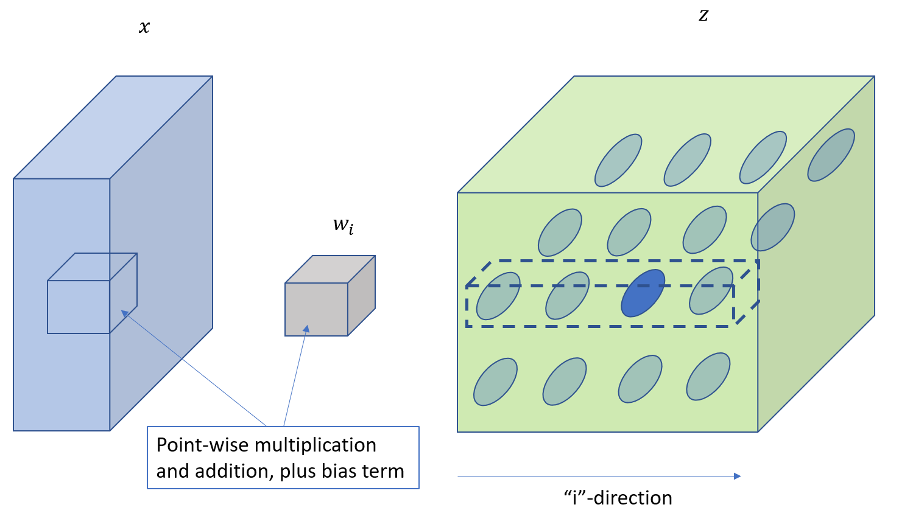
Layers: Convolutional Layer - Dimensions
It can get even more complex… but logic is the same!
Good discussion in: http://cs231n.github.io/convolutional-networks/
Output Layer
Input Layer
Receptive Field for all neurons in dashed box:
Target neurons ‘see’ full depth of input layer neurons within window
Each target neuron in dashed box has different weight/bias filter.
Each target layer neuron in same plane uses same weight/bias
3D weights for output dim ‘i’
Notes:
But this is just the surface!

Slide 45
Stride Sizes and Padding
Stride Size: Steps to skip
Padding: Augmenting input layer with zeros on edge to address edge effects
(Make sure stride size fits input and output dimensions. Pad when necessary!)
Output Size = ((W - F + 2P) / S) + 1
Example:
W = input volume size 23x23
F = receptive field size 5x5
S = stride size 4
P = padding size 0
Does it fit?

Slide 46
Stride Sizes and Padding
Stride Size: Steps to skip
Padding: Augmenting input layer with zeros on edge to address edge effects
(Make sure stride size fits input and output dimensions. Pad when necessary!)
Output Size = ((W - F + 2P) / S) + 1
Example:
W = input volume size 23x23
F = receptive field size 5x5
S = stride size 4
P = padding size 0
Does it fit?
((23 - 5 + 0)/4) + 1 = 5.5 Must be integer! Need padding..

Slide 47
Stride Sizes and Padding
Stride Size: Steps to skip
Padding: Augmenting input layer with zeros on edge to address edge effects
(Make sure stride size fits input and output dimensions. Pad when necessary!)
Output Size = ((W - F + 2P) / S) + 1
Example:
W = input volume size 23x23
F = receptive field size 5x5
S = stride size 4
P = padding size 1
Does it fit?
((23 - 5 + 2)/4) + 1 = 6 Works!

Slide 48
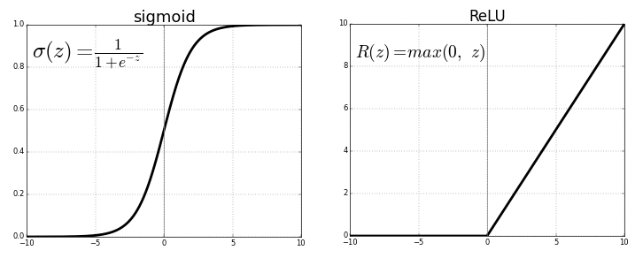
Layers: Activations
Weak training input due to small gradient. (Back-propagation picks up product of derivatives through chain-rule…)
ReLU (very common) vs. Sigmoid:
Image Source: https://towardsdatascience.com/activation-functions-neural-networks-1cbd9f8d91d6
Notes:
But this is just the surface!

Slide 49
Layers: Pooling Layer
Parameter-sharing is good. Pooling helps on top of that, reducing work and overfitting. Example:
Max-Pooling:
3 | 6 | 2 | 5
4 | 0 | 6 | 7
7 | 3 | 1 | 3
9 | 2 | 1 | 3
Hyper-parameters:
Window dimension
Stride size
Trainable Parameters:
Zero
6 | 7
9 | 3
Which stride size is applied?
Notes:
But this is just the surface!

Slide 50
Layers: Fully Connected Layers & Classification
How to transition to 1D Classifier?
Fully Connected Layers:
Connect each neuron of last conv layer with 1D layer
Use multiple layers
Classify:
Apply softmax instead of activation on last layer
Use appropriate cost function to train and classify
Notes:
Input n*n image, convolve with f*f filter ⇒ output shape = (n-f+1) * (n-f+1)
if p = padding amount (width of padded border) → output shape = (n+2p-f+1) * (n+2p-f+1)
if input image n*n, filter size f*f, padding = f, stride = s ⇒ output shape = (floor((n+2p-f)/s) + 1) * (floor((n+2p-f)/s) + 1)

Slide 51
Regularization: Dropout
Still a ton of parameters. Regularization, anyone?
Dropout is a good option (regular regularization works too..)
Invented by Geoff Hinton and team (U. Toronto), 2012 (https://arxiv.org/pdf/1207.0580.pdf)
What it does:
Randomly drop (set to zero) a fraction of activations during training. Don’t do that during evaluation(!)
Ensures that more robust features are learned
Yet another hyper-parameter:
Dropout rate
Notes:
But this is just the surface!

Slide 52
CNN Hyperparameters
Collecting an (incomplete) set of key hyper-‘parameters’:
Number of layers
Types of layers
Shape of layers (3D in our example!)
Padding approach
Filter dimensions
Step sizes
Pooling approach
Dropout rates
Optimizer…
…
…..lots to try!
Notes:
But this is just the surface!

Slide 53
VGG16: Fully Understood!
… A Question: “Why are red layers thinner than following black layers?”
Explicit sample Keras implementation: https://towardsdatascience.com/step-by-step-vgg16-implementation-in-keras-for-beginners-a833c686ae6c
Notes:
But this is just the surface!

Slide 54
Finally: CNNs in NLP
W266: Natural Language Processing

Slide 55
Paper Peeks
-> Convolutional Neural Networks for Sentence Classification <-
-> A Sensitivity Analysis of (and Practitioners' Guide to) Convolutional Neural Nets for Sentence Classification <-
Notes:
discussion of grounding problem, ambiguity in language

Slide 56
Sentence Classification with CNNs
Kim (NYU, 2014, http://www.aclweb.org/anthology/D14-1181 ) (depicting slightly more complicated ‘multi-channel’ architecture*)
* Two channels: one is standard fixed word2vec, the other set starts with word2vec and is retrained. Results are added in filters.
Notes:
But this is just the surface!

Slide 57
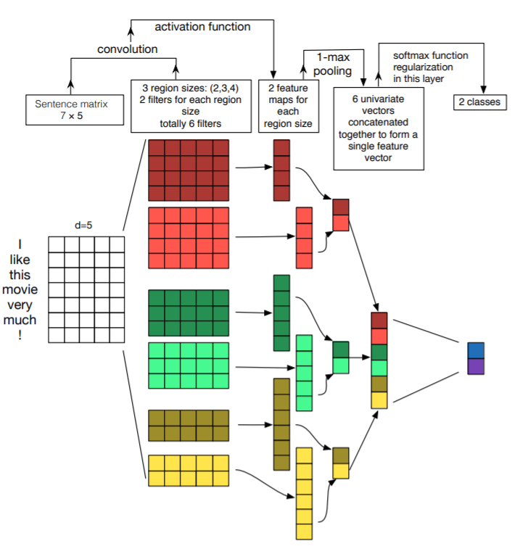
Sentence Classification with CNNs
Another View: Zhang/Wallace (UT Austin, 2014, https://arxiv.org/pdf/1510.03820.pdf )
Discussion:
Same as previous work?
Why have feature maps varying length?
...
Notes:
But this is just the surface!

Slide 58
Sentence Classification with CNNs: Calc Example
Assume first filter: W¹ = (1,3 ; -1,2 ; 1,-1)
b¹ = 3 k¹ = 3
f: tanh
H = 2
-3 -2 3 4 -1
-5 2 1 3 -1
Filter selects features (weights & bias are learned)
I am very happy today
Notes:
But this is just the surface!

Slide 59
Sentence Classification with CNNs: Calc Example
Assume first filter: W¹ = (1,3 ; -1,2 ; 1,-1)
b¹ = 3 k¹ = 3
f: tanh
H = 2
-3 -2 3 4 -1
-5 2 1 3 -1
Filter selects features (weights & bias are learned)
1 -1 1
3 2 -1
W¹
Convolution?
I am very happy today
Notes:
But this is just the surface!

Slide 60
Sentence Classification with CNNs: Calc Example
Assume first filter: W¹ = (1,3 ; -1,2 ; 1,-1)
b¹ = 3 k¹ = 3
f: tanh
H = 2
-3 -2 3 4 -1
-5 2 1 3 -1
Filter selects features (weights & bias are learned)
1 -1 1
3 2 -1
W¹
Convolution: c = f(-10 + 3) ~ -0.99
I am very happy today
Notes:
But this is just the surface!

Slide 61
Sentence Classification with CNNs: Calc Example
Assume first filter: W¹ = (1,3 ; -1,2 ; 1,-1)
b¹ = 3 k¹ = 3
f: tanh
H = 2
-3 -2 3 4 -1
-5 2 1 3 -1
Filter selects features (weights & bias are learned)
1 -1 1
3 2 -1
W¹
Convolution: c = f(4 + 3) ~ + 0.99
I am very happy today
Notes:
But this is just the surface!

Slide 62
Sentence Classification with CNNs: Calc Example
Assume first filter: W¹ = (1,3 ; -1,2 ; 1,-1)
b¹ = 3 k¹ = 3
f: tanh
H = 2
-3 -2 3 4 -1
-5 2 1 3 -1
Filter selects features (weights & bias are learned)
1 -1 1
3 2 -1
W¹
Convolution: c = f(8 + 3) ~ +0.99
I am very happy today
Notes:
But this is just the surface!

Slide 63
Sentence Classification with CNNs: Calc Example
Assume first filter: W¹ = (1,3 ; -1,2 ; 1,-1)
b¹ = 3 k¹ = 3
f: tanh
H = 2
-3 -2 3 4 -1
-5 2 1 3 -1
Filter selects features (weights & bias are learned)
c¹ = (-0.99, 0.99, 0.99) max(c¹) = 0.99
~“Yup! Feature detected!”
I am very happy today
Notes:
But this is just the surface!

Slide 64
Sentence Classification with CNNs: Calc Example
Apply many filters, different W,b, k…. Each one provides a ‘max(c)’:
-3 -2 3 4 -1
-5 2 1 3 -1
C = ( 0.99, 0.73, -0.3 ,....... )
max(c¹)
max(c³)
I am very happy today
Notes:
But this is just the surface!

Slide 65
Sentence Classification with CNNs: Calc Example
Apply many filters, different W,b, k….
-3 -2 3 4 -1
-5 2 1 3 -1
Just a vector…, can be used as input for standard FC and softmax classification!
C = ( 0.99, 0.73, -0.3 ,....... )
I am very happy today
Notes:
But this is just the surface!

Slide 66
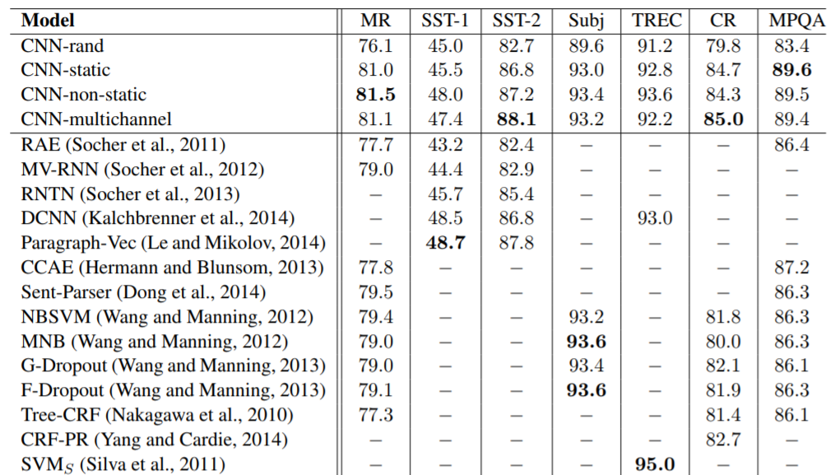
Very Good Results!
Self-trained embeddings.. Not optimal! (Only ~ 10k sentences in sets...)
Word2vec pre-trained embeddings
Initialized with Word2vec pre-trained embeddings, then trained further
Combination of fixed and trainable word2vec embeddings
Kim (NYU, 2014, http://www.aclweb.org/anthology/D14-1181 )
Notes:
We had lots of discussions in class about word embeddings…
Zeng et al. 2016: MR: sentence polarity dataset from (Pang and Lee, 2005). (2) SST-1: Stanford Sentiment Treebank (Socher et al., 2013). To make input representations consistent across tasks, we only train and test on sentences, in contrast to the use in (Kim, 2014), wherein models were trained on both phrases and sentences. (3) SST-2: Derived from SST-1, but pared to only two classes. We again only train and test models on sentences, excluding phrases. (4) Subj: Subjectivity dataset (Pang and Lee, 2005). (5) TREC: Question classification dataset (Li and Roth, 2002). (6) CR: Customer review dataset (Hu and Liu, 2004). (7) MPQA: Opinion polarity dataset (Wiebe et al., 2005). Additionally, we use (8)

Slide 67
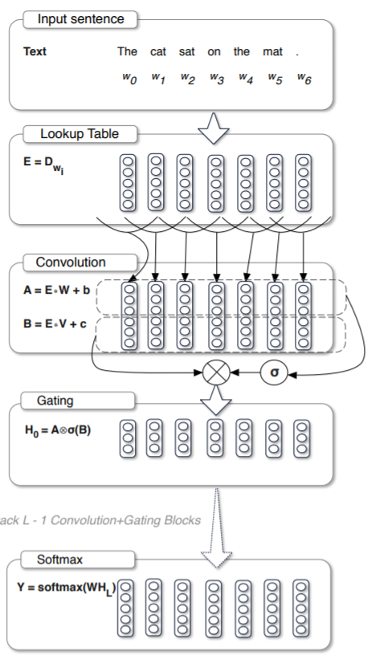
Other NLP Applications & Design Aspects
Language Models: “Language Modeling with Gated Convolutional Networks” (Dauphin et al, Facebook AI Research, 2016, https://arxiv.org/pdf/1612.08083.pdf )
Alternative to RNNs for language models (next week!)
10x faster than RNN with similar scores (in some settings)
But… part of the architecture is pretty much what we just did!
New concept though: “Gated Linear Unit” (inspired by RNNs)
Output = (E W + b) * sigma(E V + c)
Question: “How does that differ from what we did before?”
Notes:
Lots to discuss… let’s revisit after we cover LMs
Very similar to what we did...
Word embeddings (as always)
Sliding window across finite word vectors (effectively same filter size for all filters in the previous approach)
Affine transformation on concatenated word vectors
New is activation, the gating part, and the output (“Gated Linear Units”)
Inspired by RNN structure (which we will discuss later)

Slide 68
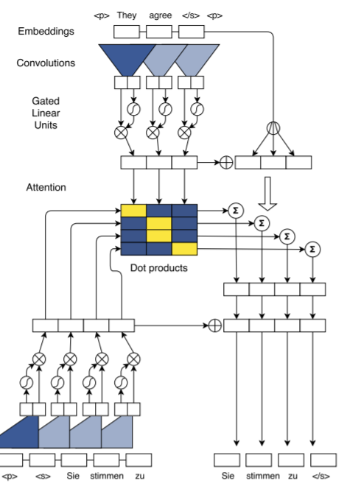
Other NLP Applications & Design Aspects
Translation: “Convolutional Sequence-to-Sequence Learning” (Gehring at al, Facebook AI Research, 2017, https://arxiv.org/pdf/1705.03122.pdf )
Alternative to RNNs for translation models (later!)
10x faster than RNN with excellent scores
Lots to discuss… let’s revisit after we cover Translations..
But… again… part of the architecture is pretty much what we just did!
Word embeddings (as always)
Sliding window across finite word vectors
“Gated Linear Units” of previous article are used
Notes:
But this is just the surface!

Slide 69
That’s it for today!
W266: Natural Language Processing

Slide 70
Layers: Convolutional Layer - Dimensions
Exercise:
Input Layer has: 256 x 256 x 3 dimensions
Filter Dimensions (width & height): 3 x 3
Output layer: 256 x 256 x 12 dimensions
…. How many weight and bias parameters?
Notes:
But this is just the surface!

Slide 71
Layers: Convolutional Layer - Dimensions
Breakout Room (5 min)
Notes:
But this is just the surface!

Slide 72
Layers: Convolutional Layer - Dimensions
Exercise:
Input Layer has: 256 x 256 x 3 dimensions
Filter Dimensions (width & height): 3 x 3
Output layer: 256 x 256 x 12 dimensions
…. How many weight and bias parameters? (3 x 3 x 3 + 1) x 12 = 336 …… a lot better than what we had on slide 11!
Notes:
But this is just the surface!

Slide 73
(Old) Layers: Convolutional Layer - Comments
Why do Convolutional Layers can have ‘thickness’?:
More filters to look for more features!
0 | 0 | 0 | 1 | 1 | 1 | 0 | 0 | 1 | 1 | 1 | 1 | 0 | 0
W_{A1} | W_{A2} | W_{A3}
“Search for vertical edges...”
W_{B1} | W_{B2} | W_{B3}
“Search for horizontal edges ….”
W_{C1} | W_{C2} | W_{C3}
“Search for ...”
Resulting layer has ‘thickness’!
0 | 0 | 0 | 1 | 1 | 1 | 0 | 0 | 1 | 1 | 1 | 1 | 0 | 0
0 | 2 | 1 | 1 | 0 | -1 |  | 0 | 1 | 1 | 1 | 1 | 0 | 0
0 | 0 | 0 | 1 | 0 | 1 | 0 | 0 | 1 | 1 | 1 | 1 | 0 | 0
Notes:
But this is just the surface!

Slide 74
Layers: Convolutional Layer - Dimensions
What if my input also has 'thickness', let's say two channels ?:
0 | 0 | 0 | 1 | 1 | 1 | 0 | 0 | 1 | 1 | 1 | 1 | 0 | 0
0 | 0 | 0 | 1 | 1 | 1 | 0 | 0 | 1 | 1 | 1 | 1 | 0 | 0
W_{AK1} | W_{AK2} | W_{AK3}
W_{AJ1} | W_{AJ2} | W_{AJ3}
“Search for vertical edges...”
W_{BJ1} | W_{BJ2} | W_{BJ3}
“Search for horizontal edges ….”
+
W_{CJ1} | W_{CJ2} | W_{CJ3}
“Search for ...”
0 | 0 | 0 | 1 | 1 | 1 | 0 | 0 | 1 | 1 | 1 | 1 | 0 | 0
0 | 0 | 0 | 1 | 1 | 0 | 0 | 0 | 1 | 1 | 1 | 1 | 0 | 0
0 | 0 | 0 | 1 | 0 | 1 | 0 | 0 | 1 | 1 | 1 | 1 | 0 | 0
Notes:
But this is just the surface!

Slide 76
Sentence Classification with CNNs
(Following Zhang/Wallace) Basic Logic:
Consider Source Sentence: [‘I’, ’am’, ’very’, ‘happy’, ’today’]
Notes:
But this is just the surface!

Slide 77
Sentence Classification with CNNs
Kim (NYU, 2014, http://www.aclweb.org/anthology/D14-1181 ) Basic Logic:
Consider Source Sentence: [‘I’, ’am’, ’very’, ‘happy’, ’today’]
Use sentence embedding X: [x₁, x₂ , x₃ , x₄ , x₅] (dim: n x H (H: embed dim))
Notes:
But this is just the surface!

Slide 78
Sentence Classification with CNNs
Kim (NYU, 2014, http://www.aclweb.org/anthology/D14-1181 ) Basic Logic:
Consider Source Sentence: [‘I’, ’am’, ’very’, ‘happy’, ’today’]
Use sentence embedding X: [x₁, x₂ , x₃ , x₄ , x₅] (dim: n x H (H: embed dim))
Filter by ‘windowing’ over k consecutive word vectors and, at each step i:
Filter W dim: k x H (k < n!) [plus 1 bias number]
Output at position i: c_{i} = Tr(X_{i} W^{T}) + b [X_{i}: n vectors in neighborhood of pos i]
Notes:
But this is just the surface!

Slide 79
Sentence Classification with CNNs
Kim (NYU, 2014, http://www.aclweb.org/anthology/D14-1181 ) Basic Logic:
Consider Source Sentence: [‘I’, ’am’, ’very’, ‘happy’, ’today’]
Use sentence embedding X: [x₁, x₂ , x₃ , x₄ , x₅] (dim: n x H (H: embed dim))
Filter by ‘windowing’ over k consecutive word vectors and, at each step i:
Filter W dim: k x H (k < n!) [plus 1 bias number]
Output at position i: c_{i} = Tr(X_{i} W^{T}) + b [X_{i}: n vectors in neighborhood of pos i]
Get the max for each filter (use many filters, use different sizes!)
Notes:
But this is just the surface!

Slide 80
Sentence Classification with CNNs
Kim (NYU, 2014, http://www.aclweb.org/anthology/D14-1181 ) Basic Logic:
Consider Source Sentence: [‘I’, ’am’, ’very’, ‘happy’, ’today’]
Use sentence embedding X: [x₁, x₂ , x₃ , x₄ , x₅] (dim: n x H (H: embed dim))
Filter by ‘windowing’ over k consecutive word vectors and, at each step i:
Filter W dim: k x H (k < n!) [plus 1 bias number]
Output at position i: c_{i} = Tr(X_{i} W^{T}) + b [X_{i}: n vectors in neighborhood of pos i]
Get the max for each filter (use many filters, use different sizes!)
Concatenate
Notes:
But this is just the surface!

Slide 81
Sentence Classification with CNNs
Kim (NYU, 2014, http://www.aclweb.org/anthology/D14-1181 ) Basic Logic:
Consider Source Sentence: [‘I’, ’am’, ’very’, ‘happy’, ’today’]
Use sentence embedding X: [x₁, x₂ , x₃ , x₄ , x₅] (dim: n x H (H: embed dim))
Filter by ‘windowing’ over k consecutive word vectors and, at each step i:
Filter W dim: k x H (k < n!) [plus 1 bias number]
Output at position i: c_{i} = Tr(X_{i} W^{T}) + b [X_{i}: n vectors in neighborhood of pos i]
Get the max for each filter (use many filters, use different sizes!)
Concatenate
Classify
Notes:
But this is just the surface!

